Slide 1



AI Course Final Project
Author: Shimu Begum
Created with Pi

Slide 2

CONTENTS
1. Introduction
2. Course Objectives
3. Theory Topics Covered
4. Algorithms Implemented (Lab Task)
5. AI Game - Chess
6. AI Game - Snake
7. AI Game - Tic Tac Toe
8. Tools Used
9. What I Learned
10. Supervisor & Acknowledgment
11. Thank You!

Slide 3

01
Introduction

Slide 4
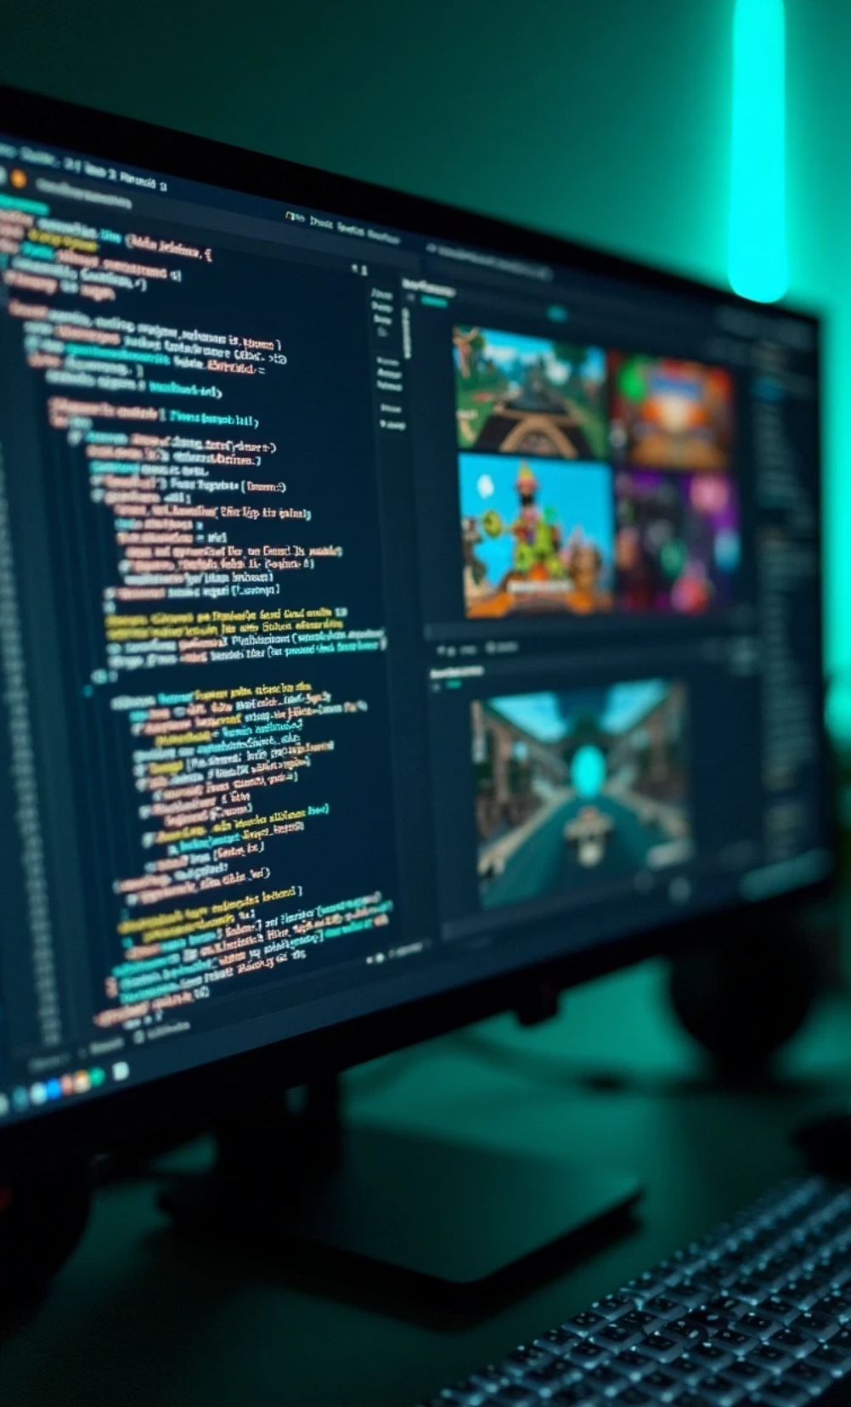

Introduction
1
This AI course focused on both theoretical concepts and hands-on lab tasks.
2
The project includes:
• Algorithm implementation
• Game development
• Use of AI tools

Slide 5

02
Course Objectives

Slide 6




Course Objectives
Understand core concepts of Artificial Intelligence
Implement classical search algorithms
Develop games using AI techniques
Explore modern AI tools for presentations and videos

Slide 7

03
Theory Topics Covered

Slide 8
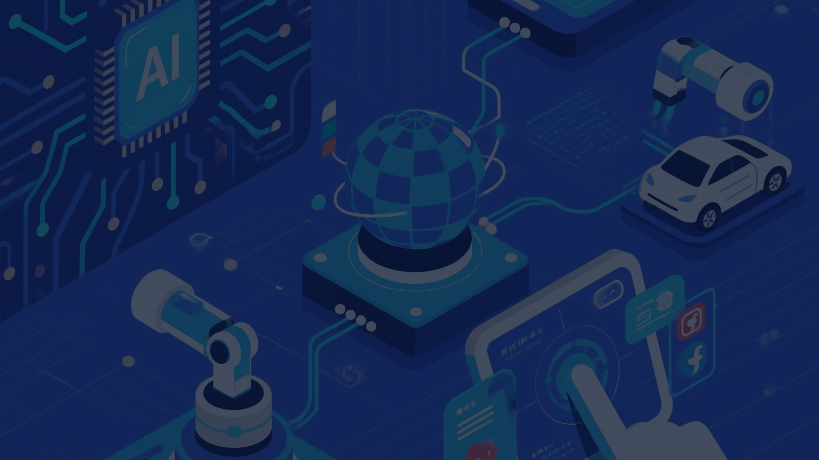
Theory Topics Covered
1
Introduction to AI
2
Problem Solving
3
Uninformed and Informed Search
4
Game Playing
5
AI Tools Overview

Slide 9

04
Algorithms Implemented (Lab Task)

Slide 10

Algorithms Implemented (Lab Task)
BFS (Breadth-First Search)
DFS (Depth-First Search)
DLS (Depth-Limited Search)
IDS (Iterative Deepening Search)
Best First Search
Beam Search
Bidirectional Search
AND-OR Graphs
Minimax
Alpha-Beta Pruning

Slide 11

05
AI Game - Chess

Slide 12

AI Game - Chess
1
Two-player game with AI opponent
2
Algorithm used: Minimax with Alpha-Beta Pruning
3
Developed using Python and Pygame

Slide 13
06
AI Game - Snake

Slide 14



AI Game - Snake
Classic snake game
Logic-based AI path movement
Developed using Python

Slide 15
07
AI Game - Tic Tac Toe

Slide 16
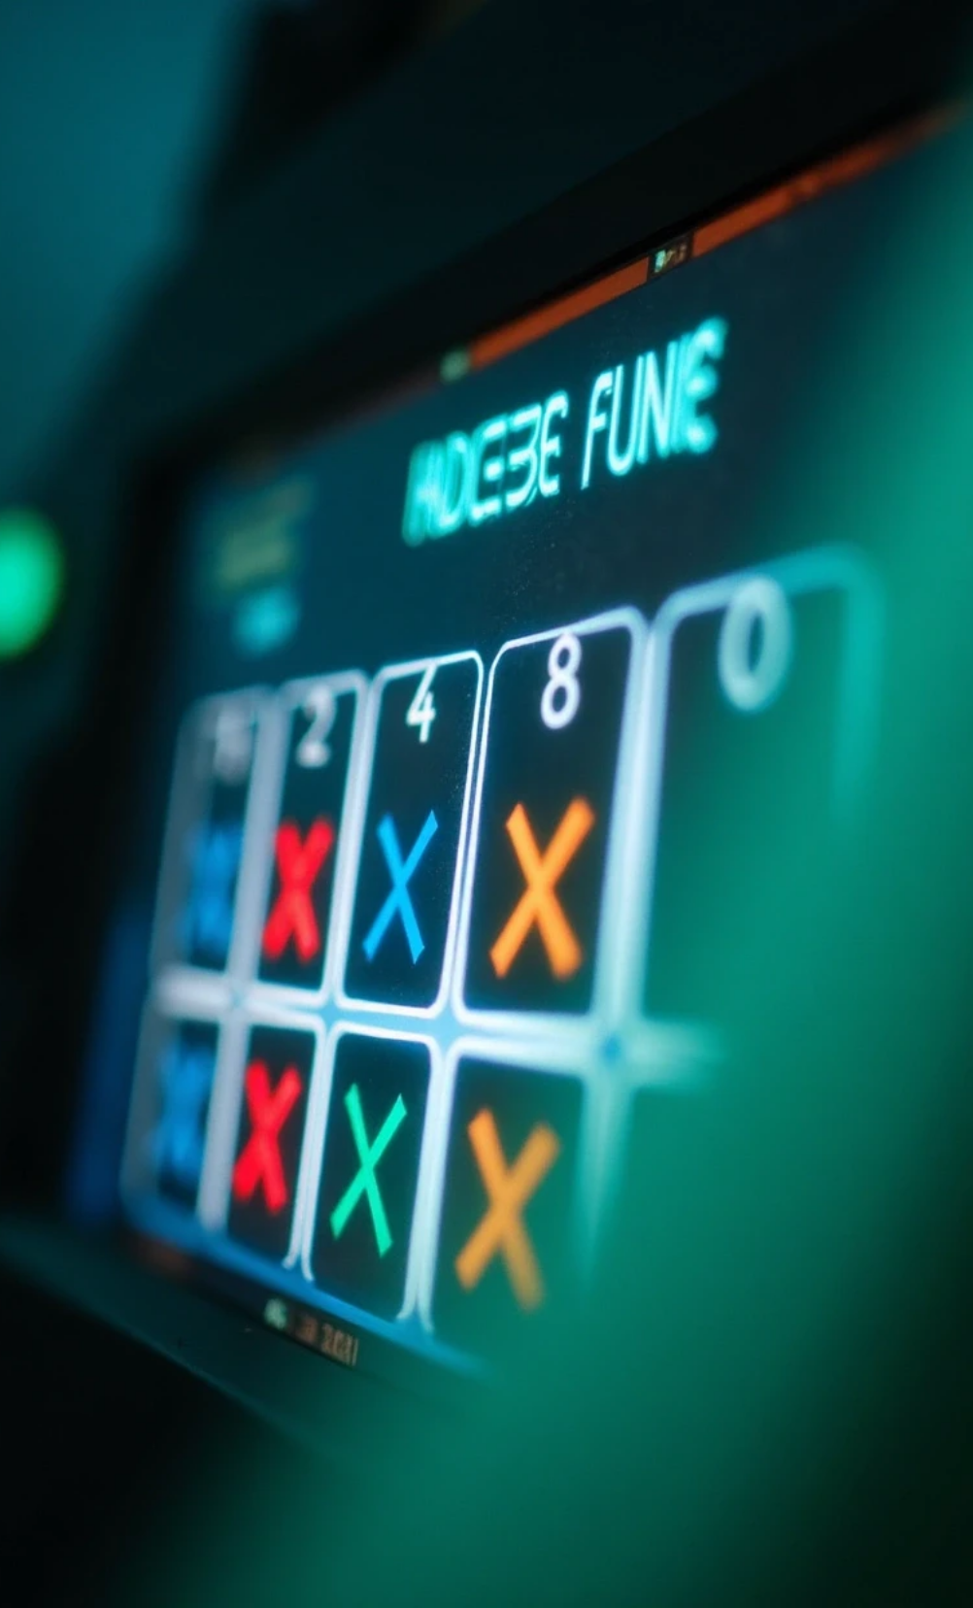
AI Game - Tic Tac Toe
1
Human vs Computer
2
Algorithm: Minimax
3
Detects win, lose or draw automatically

Slide 17
08
Tools Used

Slide 18



Tools Used
Video created using: Pictory.ai
Presentation designed with: AI support (ChatGPT/Tome)
Documentation: README written using ChatGPT

Slide 19
09
What I Learned

Slide 20

What I Learned
1
Practical understanding of AI algorithms
2
Building game logic with AI
3
Using AI tools for documentation and presentation
4
Improved coding and communication skills

Slide 21
10
Supervisor & Acknowledgment

Slide 22



Supervisor & Acknowledgment
Supervisor: Mr. Razorshi Prozzwal Talukder
Special thanks to my teacher and university
Grateful for AI tools that helped enhance this project

Slide 23
11
Thank You!

Slide 24
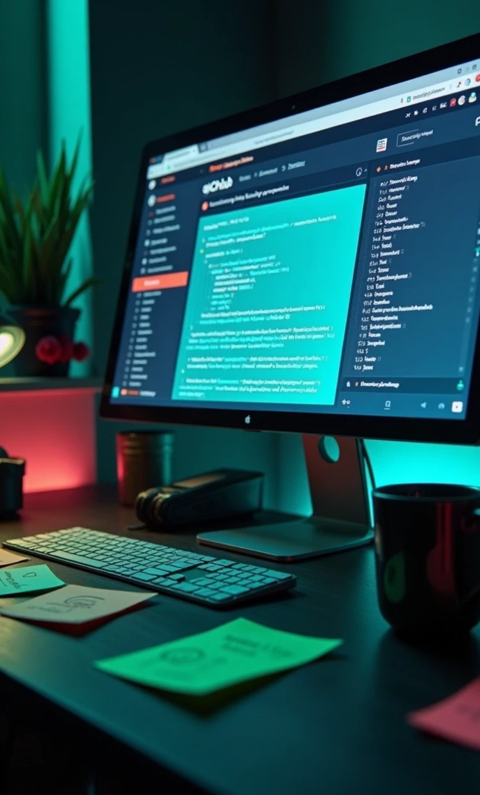
Thank You!
1
GitHub Repository: github.com/shimu615/AI-Course
2
Feel free to explore the code, games, and documentation.

Slide 25
Thank You

